Slide 1



F12
TEAM
TEAM PROJECT
ThinkTwice

Slide 2

CONTENT
01
OUR TEAM
02
GETTING STARTED
03
PRODUCT IDEA OVERVIEW
04
ANALYSIS OF SIMILAR APPLICATIONS

Slide 3
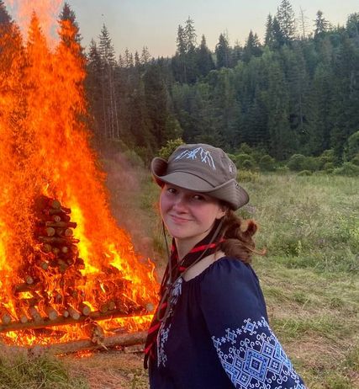
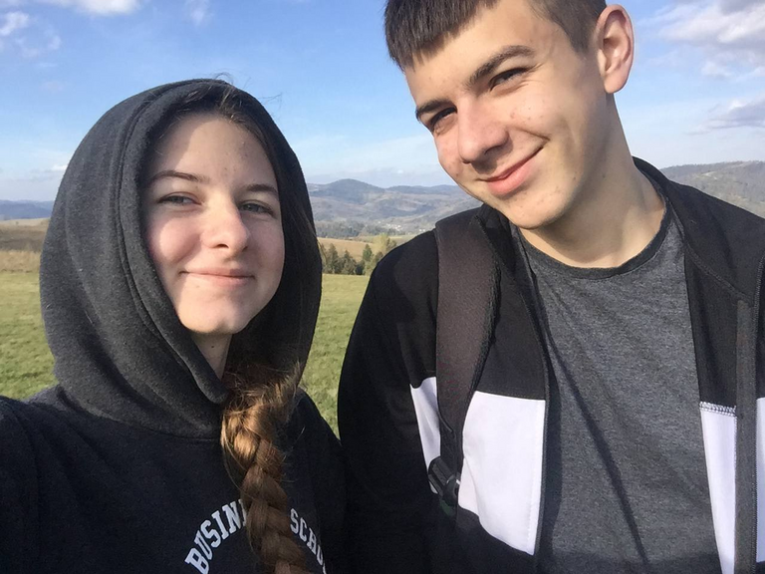
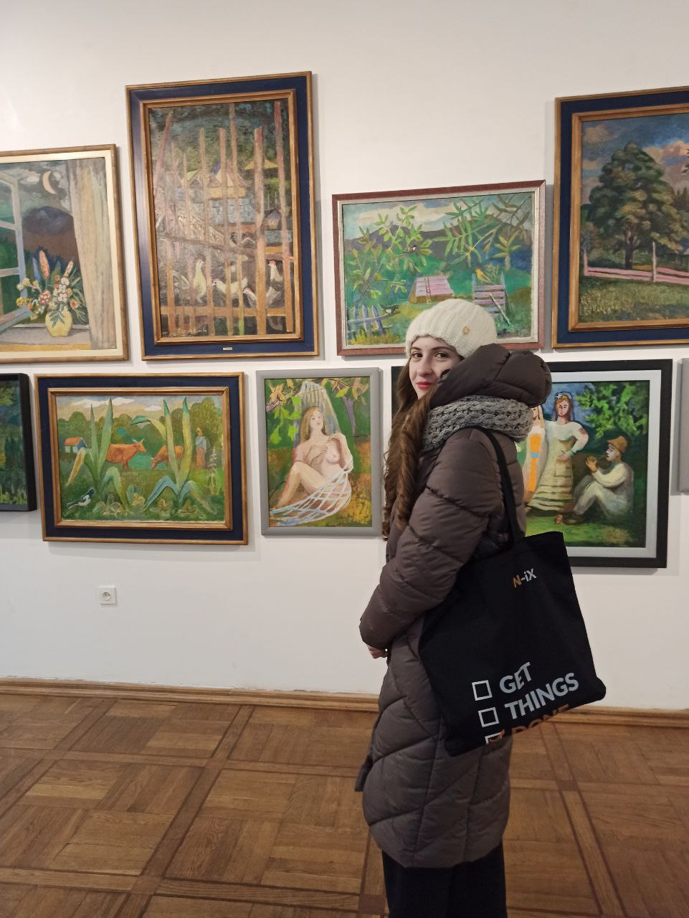

F12 TEAM
Падалка
Марічка
Гошко
Софія
Гатала
Олена

Slide 4

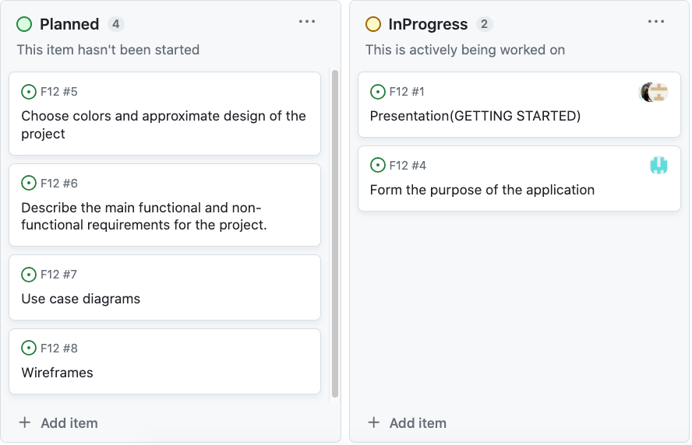
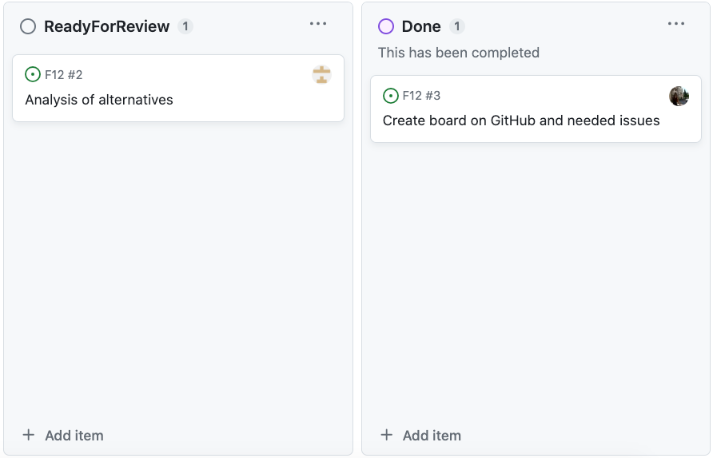
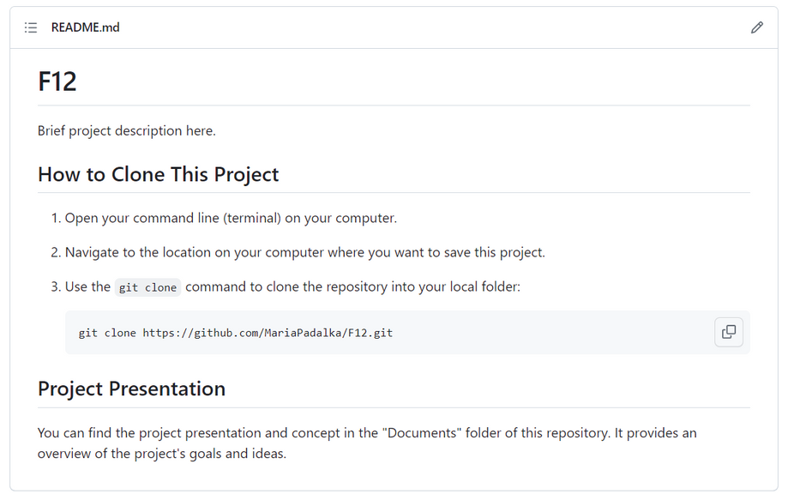
GETTING STARTED

Slide 5






PRODUCT IDEA OVERVIEW
Setting a convenient
space
Сost and income analysis
Сonnection with
the bank
Tracking finances
Data visualization

Slide 6




ANALYSIS OF ALTERNATIVES

Slide 7
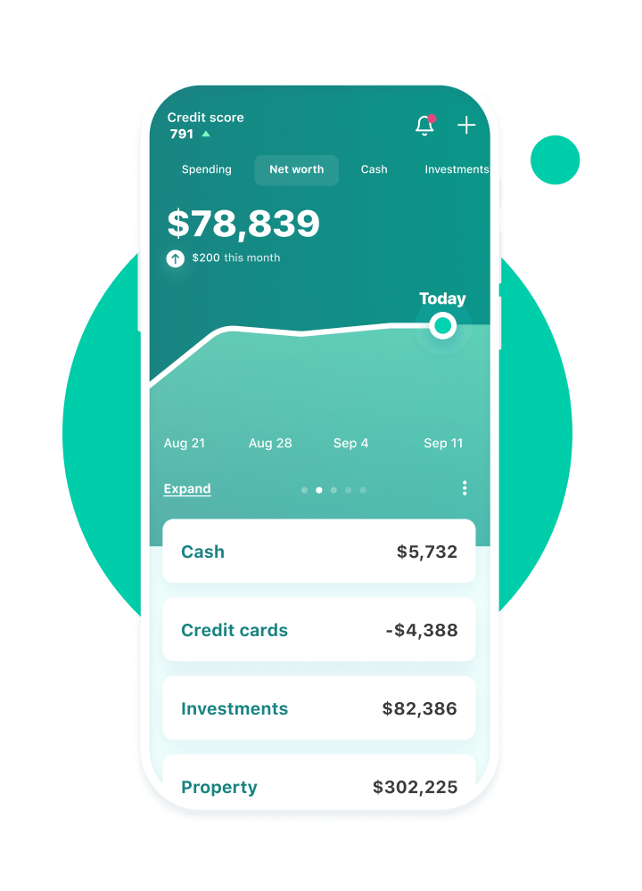

brings together everything from spending, balances, and budgets to your credit score
automatically categorizes transactions
sends personalized insights to spend smarter, save more, and pay down debt

Slide 8
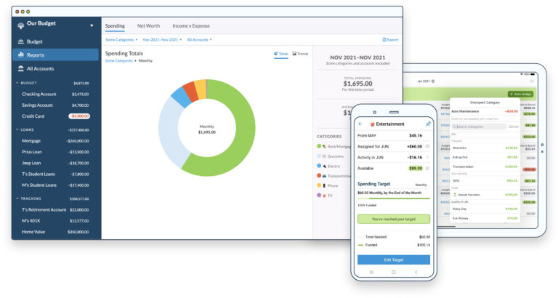

securely links bank accounts and imports transactions
real-time sync across devices
teaches how to use budget to make spending decisions

Slide 9

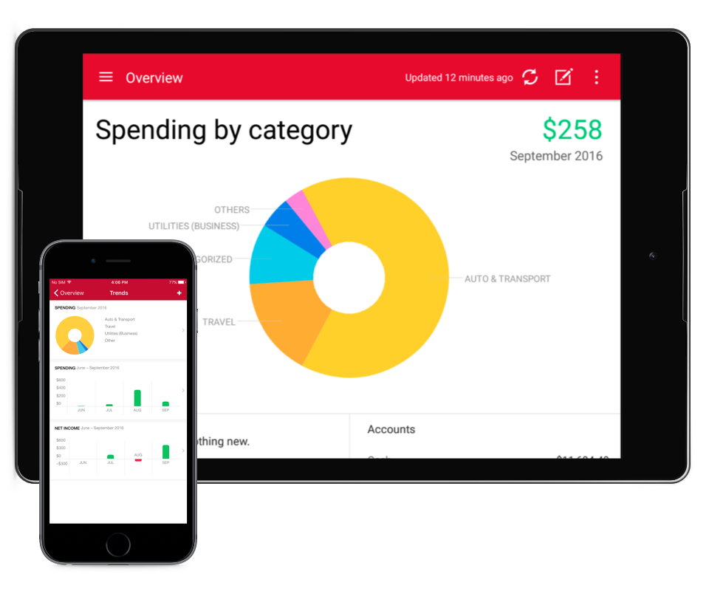
helps to manage spending & see where money goes
uncovers more ways to save
sees all accounts together, prepares for taxes & plans for retirement

Slide 10
THANK'S FOR WATCHING
F12
TEAM

